Slide 1

Session 2
Unlocking your mind

Slide 2
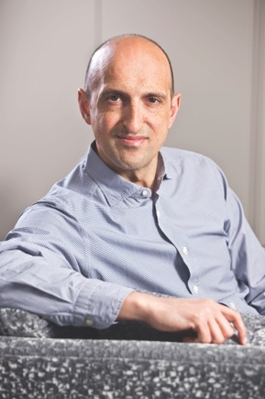
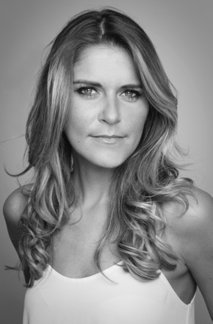
Welcome back! We hope that you enjoyed Session 1 – now let’s start Session 2 of your journey towards secondary school. We have some guides to help you through today: Matthew Syed and Gemma Oaten.
Matthew Syed
Gemma Oaten

Slide 3

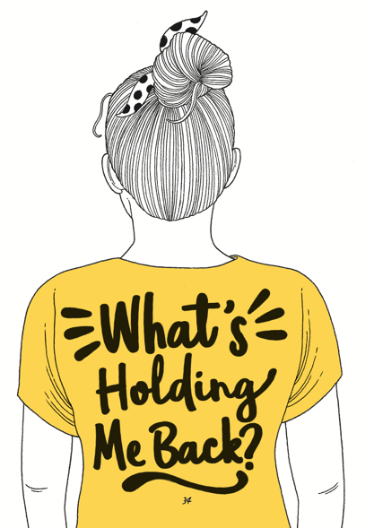
Last session, we decided we wanted to go…
And we asked this question…
We decided
to CHOOSE our attitude.

Slide 4
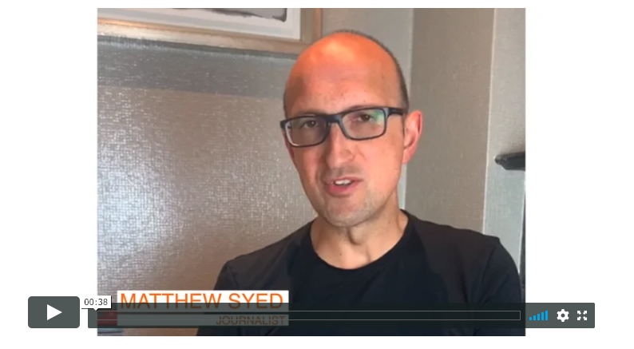

Here is Matthew to introduce today’s session:
If you are reading ‘You Are Awesome’ alongside these sessions, then read from page 46 to 93. It doesn’t matter if you don’t read it all in one go!

Slide 5
Today, we are looking at that amazing thing inside your head…YOUR BRAIN.
We are looking at whether you think people have a fixed mindset or a growth mindset… more of that in a moment!

Slide 6
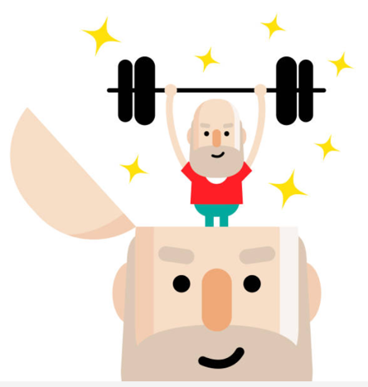
Did you know that…
Your mind is VERY POWERFUL
Your mind controls your THOUGHTS
Your mind allows you to FOCUS
Your mind will help you ACHIEVE

Slide 7
Can you unlock your mind? Can you lock your mind?
…YES YOU CAN!
You can do both.
It is a choice.

Slide 8
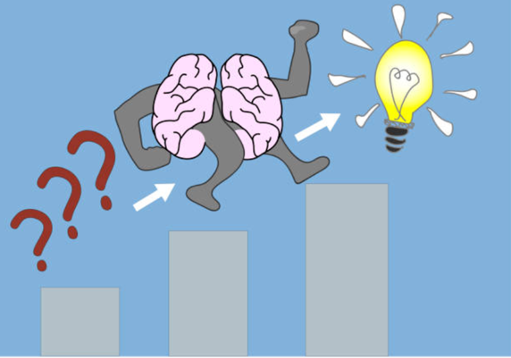
Carol Dweck, a famous psychologist, says there are two types of mindsets:
Growth Mindset
Fixed Mindset

Slide 9
Growth mindset is…

Slide 10
Let’s understand the fixed mindset
Fixed mindset
People think you can ONLY be good at something if you are born ‘gifted’ or ‘talented’. You either think you have a talent for something, or you don’t. There is nothing you can do to change it, no matter how hard you try. People think they are born: Good at maths Brilliant at tennis Able to sing like an opera diva! Able to nail the dragon flip on a skateboard on the first go!
The problem with this mindset is that if you believe you are born great at things (or not), then you also believe that you can’t practise or try hard to improve because it wouldn’t make a difference. You either have it or you don’t.
Read pages 52 – 53 of ‘You Are Awesome’.

Slide 11
So people who struggle think it will always be this way, and people who don’t struggle assume that they are intelligent for life. They are both wrong!
People with a fixed mindset say some of these things…
We are all rubbish at maths in our family.
I have always been bright.
My memory has always been bad; I can’t remember things.
I am not very confident.
I don’t have the co-ordination for sport.
Hard work is for other people; I am a natural.

Slide 12
Let’s understand the growth mindset
Growth mindset
People believe that their intelligence and ability can be improved with effort and the right strategies. They confront challenges. They have a passion for learning. They view failure as a springboard for growth.
This mindset is linked to happiness and achievement in life.
Read pages 52 – 53 ‘You Are Awesome’.

Slide 13
People with a GROWTH mindset say some of these things…
I am not able to do this… YET!
If I put more effort in, I will get better.
Feedback will help me to get better.
I welcome new challenges.
I sometimes make mistakes and that is good because I can learn from them and get even better.
I can improve in this area, if I practise.

Slide 14
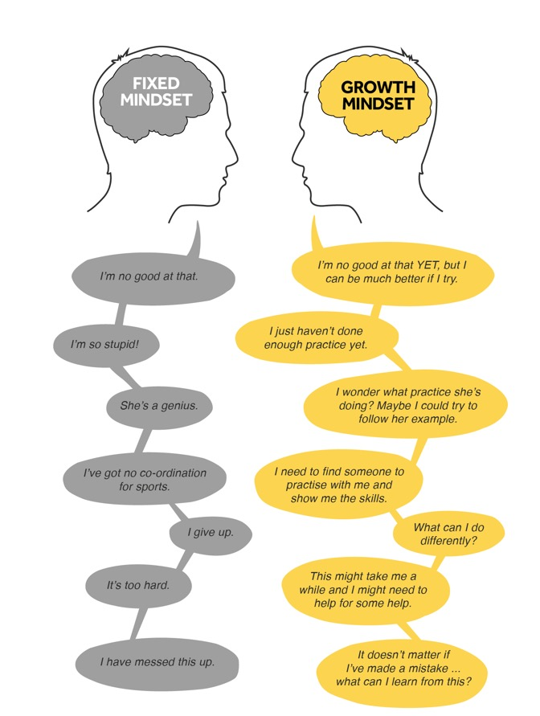
What might you think in each
mindset?
TASK:
Look at these two people, each with a different mindset.
Which mindset are you and why?
Does it change depending on different situations in your life?
Are you someone who thinks that you are just born intelligent?

Slide 15
Let’s STAY on our AWESOME MISSION and understand how we can get a growth mindset and change those fixed mindset voices we hear in our heads.
When your brain tries to tell you, ‘you can’t do this because XXXXX’, make sure you tell it that it is talking nonsense! Control those thoughts and don’t allow them to get you into a fixed mindset headlock.

Slide 16

That means we have to wrestle some of the other negative thoughts away.
There are ways of doing this.

Slide 17
Activity: The Worry Jar
What are the things you tend to worry about which might stop you from trying something new or hard?
Write them down on strips of paper (or you can write them down in your booklet).
Put those strips of paper in a worry jar – any jam jar or a pot will do.
In a week’s time, look at the strips of paper again (maybe with a parent or sibling) and see if the worries still apply.
Throw away the ones that don’t.
Take a look at the ones that are still worrying you. Is there someone you can talk to about these?

Slide 18
You can only change the way you think if you practise. You need to get the right kind of practice.
Practise skills which will help you achieve your goals.
Do your research or ask for help so that you know what to practise.
Practise specific things.
Test yourself from memory.
Practise things over and over again.
Practise things in different ways.
Challenge yourself.
“All highly competent people continually search for ways to keep learning, growing, and improving.”
Benjamin Franklin
Notes:
It would be worth researching who Benjamin Franklin was and what he did - and therefore why this quote is a valuable/inspirational one.

Slide 19
At secondary school, you will…
Do subjects you have never done before
Be asked to work in ways that are new
Work with people who are different to you
Find work challenging because it is a new key stage
Find that you have forgotten a lot because you haven’t been in school for a while
Be with people who you think are more clever than you
Be with people who you think are perhaps not as clever as you.
What will your brain say when you face these things?
Will it say ‘I can’t do it’, ‘I won’t ever be able to do it’ OR will it say,
‘I am going to try hard, practise and not give up’?

Slide 20
Don’t fear failure. Failure is how we learn to be better!
Most people who have success have all made lots of mistakes and ‘failed’ before that success.
If you don’t believe us…

Slide 21
J.K. Rowling was 32 years old when the first Harry Potter book was published. 12 publishers rejected her manuscript. She never gave up, even though 12 publishers didn’t think Harry Potter would come to much.
“Failure taught me things about myself that I could have learned no other way. I discovered that I had a strong will, and more discipline than I had suspected.”
- J.K. Rowling

Slide 22
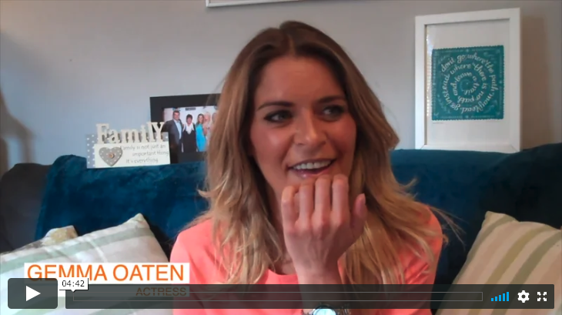
Gemma is here again, this time to tell us about her experience of never giving up!

Slide 23
Use this time before Year 7 to have a go at things.
TASK:
Identify three things that you say you ‘can’t do’. Write them down.
Now write each thing down using a growth mindset approach. For example, ‘I can’t do maths’ turns into, ‘I am going to practise the things in maths that I can’t do yet’.
Think of something you’ve always wanted to get better at. Write it down. How could you practise that thing now?

Slide 24
Year 7 is about trying your best, giving new things a try, not labelling yourself, making mistakes and practice, practice, practice.
Keep the RIGHT mindset and you will BE AWESOME!

Slide 25
© 2020 The PiXL Club Ltd and Hachette UK
This resource may be shared with any primary school Year 6 student in its current form, and parts thereof, to enhance your transition work with students. All opinions and contributions are those of the authors. The contents of this resource are not connected with, or endorsed by, any other company, organisation or institution.
If there are any inadvertent omissions or errors in the acknowledgements or usage, this is unintended and we will remedy these on written notification.
Hachette UK own 'You Are Awesome' by Matthew Syed and 'Go Big' by Matthew Burton, which may be purchased by individuals and schools, should they wish to do so to enhance these resources for students. 'You Are Awesome' illustrations copyright © Toby Triumph. 'Go Big' illustrations copyright © Chris Madden.

