Slide 1

Finding
Your way. . .

Slide 2
Going any where new can be a bit scary, especially when it seems so BIG!
Don’t worry. . .
Finding your way around will become easier every day and we are all here to help you.

Slide 3
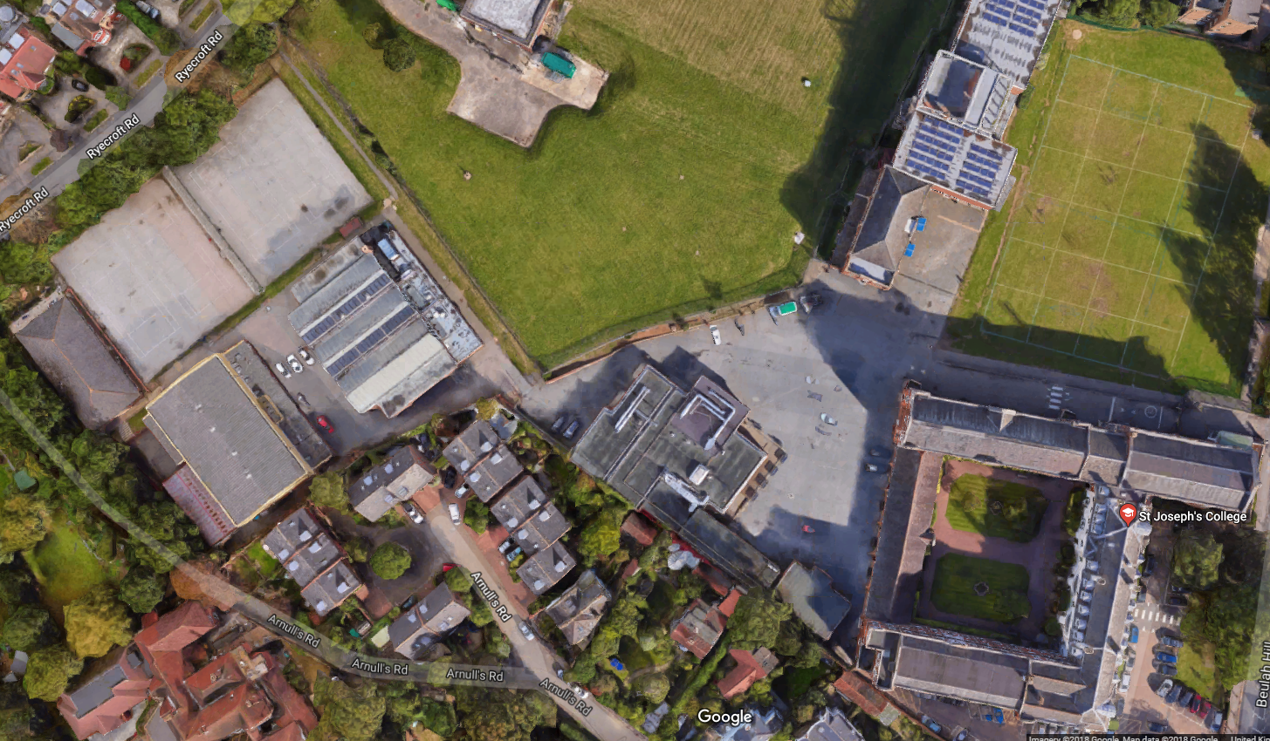
8
7
9
1
6
4
2
10
3
5
12
14
11
15
13
1
Lower School Play ground
Lower school – RE
Sports hall and Lower school covered area.
Swimming Pool.
5
DT, Food Tech and Engineering, toilets, and 6th Form Café.
Art, Drama & Library.
Gym, PE Changing rooms, toilets, weights room.
Main Hall, Music, Science.
9
The Meadow.
The Main Playground (years 9, 10, 11, 12 & 13)
School Canteen
The North Block –
English & Maths
13
The South Block – Languages, History & Geography, IT.
The Chapel.
Reception and Administration offices.
Medical (via the quad)
2
6
10
14
3
7
11
15
4
8
12
12

Slide 4

RE 3
RE 4
2
Year 7
Playground
1
Year 8
Playground
RE 2
RE 1
Lower
Site
3
4
Sports
Hall
Swimming
Pool
To Upper Site

Slide 5
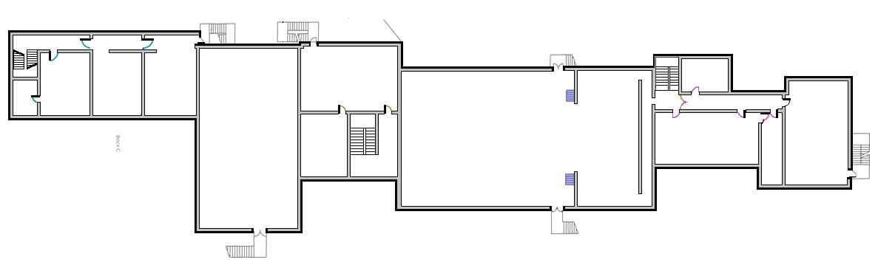
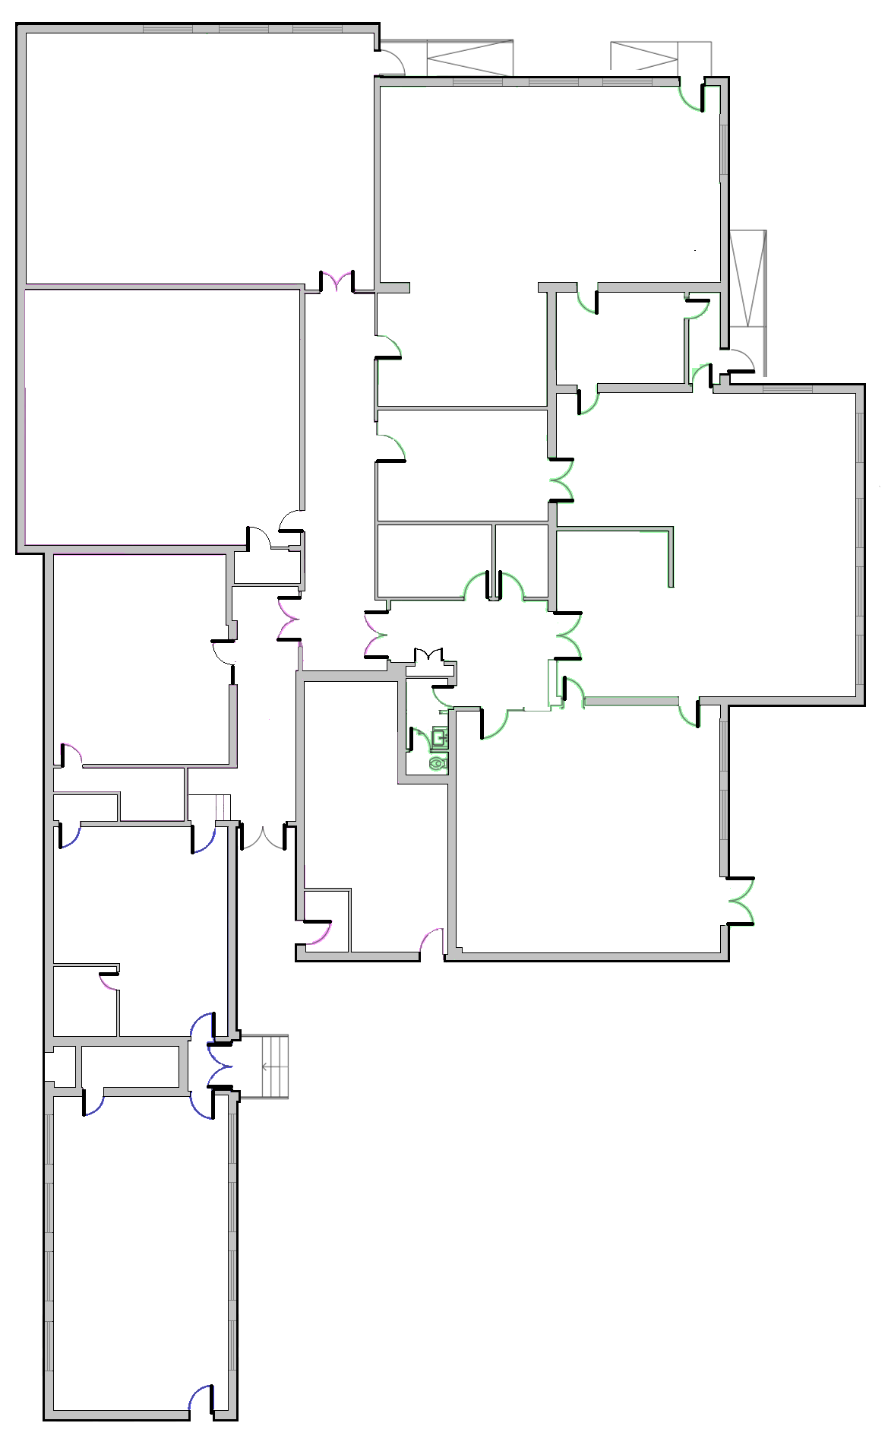
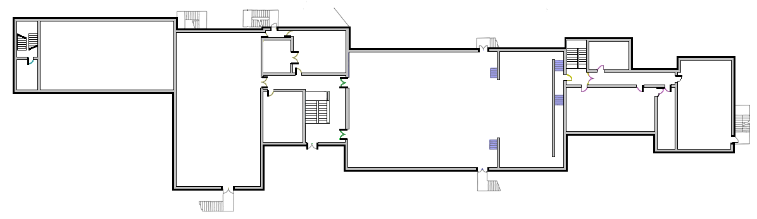
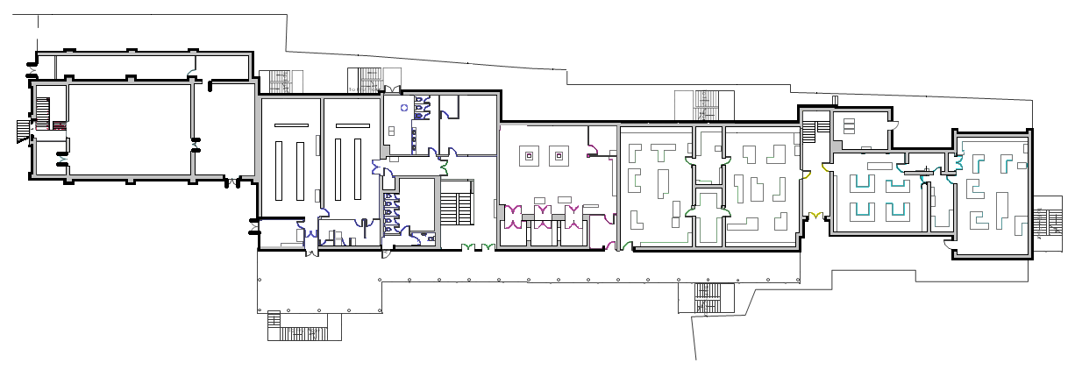
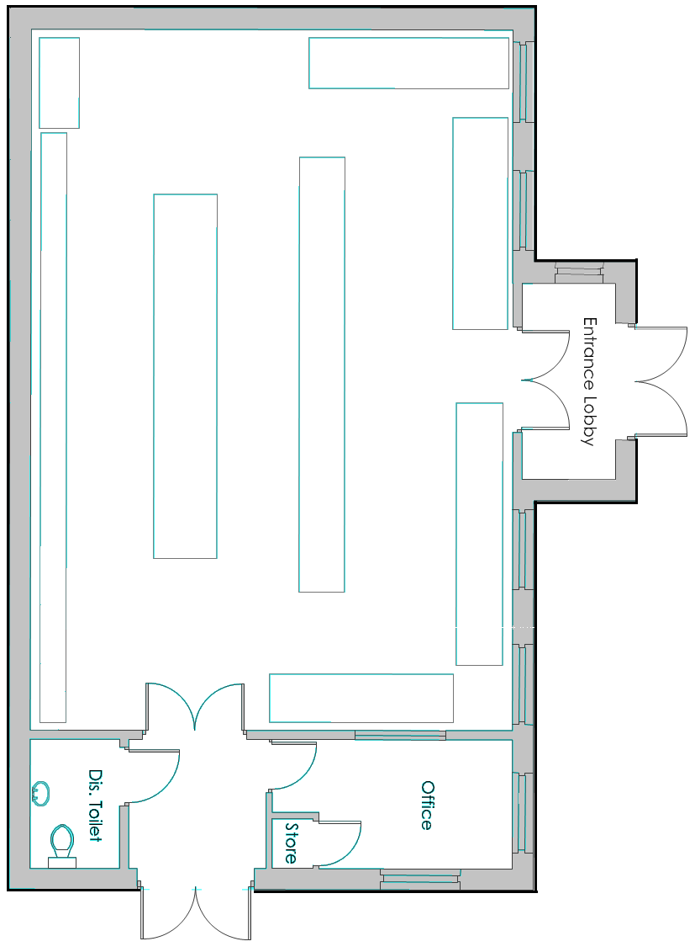
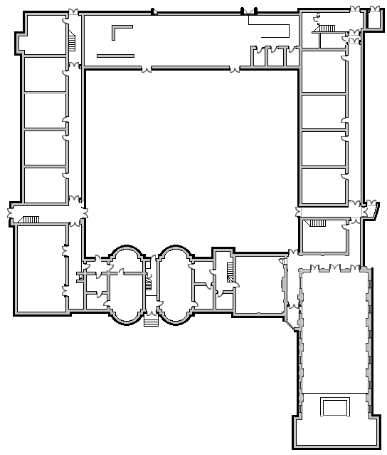
To Lower Site
H11
H12
H13
H21
T04
T05
SECOND
FLOOR
H21
SC21
SC22
T03
5
Kitchen
Store
11
GYM
HALL
SC11
SC12
Year 12/13
Cafe
FIRST
FLOOR
H14
Toilet
T02
6
7
8
10
T01
H01
H02
PE
CHANGING
ROOM
MU01
SC01
SC02
SC03
SC04
GROUND
FLOOR
Toilet
CISCO
9
11
12

Slide 6
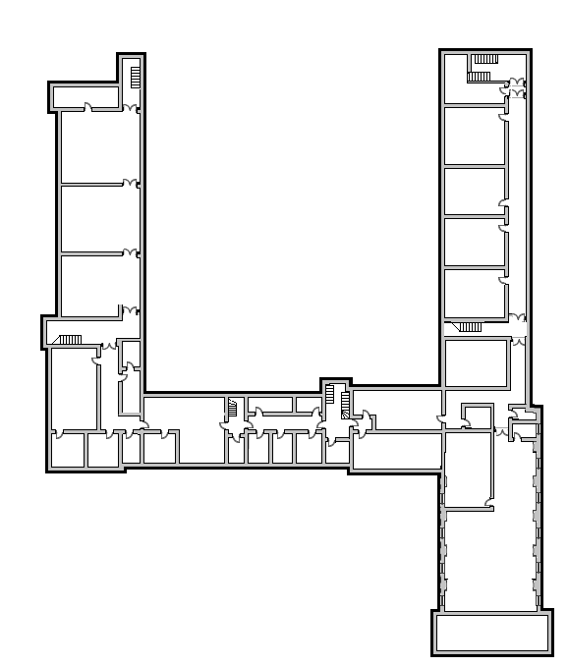
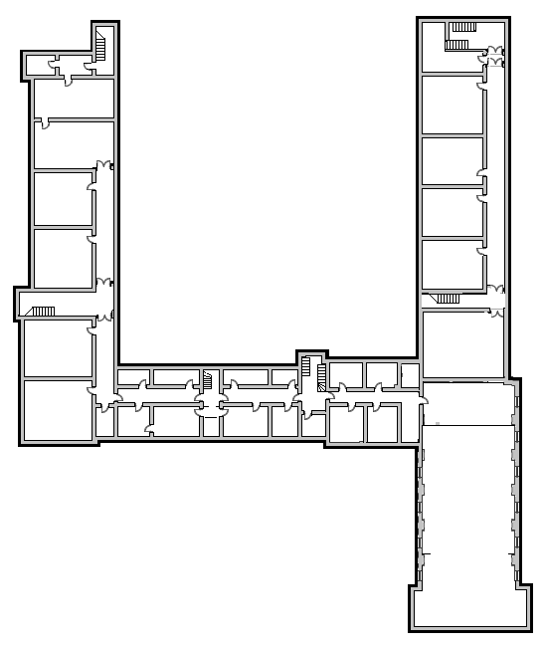
The Main Building
South
Ground
Floor
North
South
First
Floor
North
South
Second
Floor
North
13
12
The Canteen
11
S04
N05
S16
N15
S24
N25
S03
N04
S15
N14
N24
N03
S14
S23
N23
S02
N13
S01
N02
S13
N12
S22
N22
The
Staff
Room
Medical
N01
N11
N21
S12
S21
15
V01
The
Chapel
S11
Reception
14
Senior Leadership
& Admin offices
Learning Support
& Counselling
Year 12 & 13
Study Centre
AR
Basement

